Slide 1

Learning Objectives
LO1 Construct a chart of accounts for a service business organized as a proprietorship.
LO2 Demonstrate correct principles for numbering accounts.
LO3 Apply file maintenance principles to update a chart of accounts.
LO4 Complete the steps necessary to open general ledger accounts.
© 2014 Cengage Learning. All Rights Reserved.

Slide 2
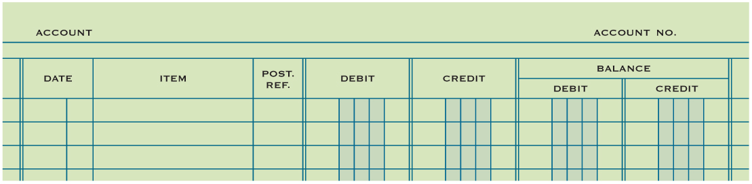
Account Form
Lesson 4-1
Used to summarize in one place all the changes to a single account
A separate form for each account
Sample of a blank account form

Slide 3
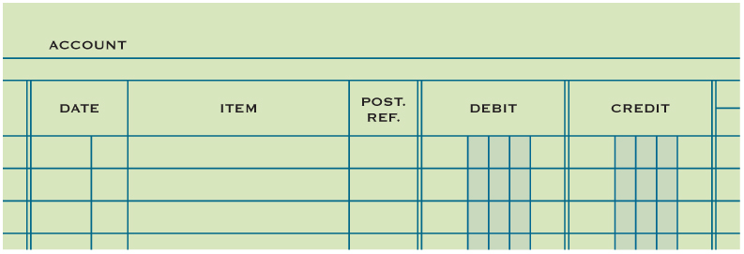
Relationship of a T Account to an Account Form
Lesson 4-1
Information needed to trace entry back to journal page.
T Account
Debit side
Credit side
Balance columns

Slide 4
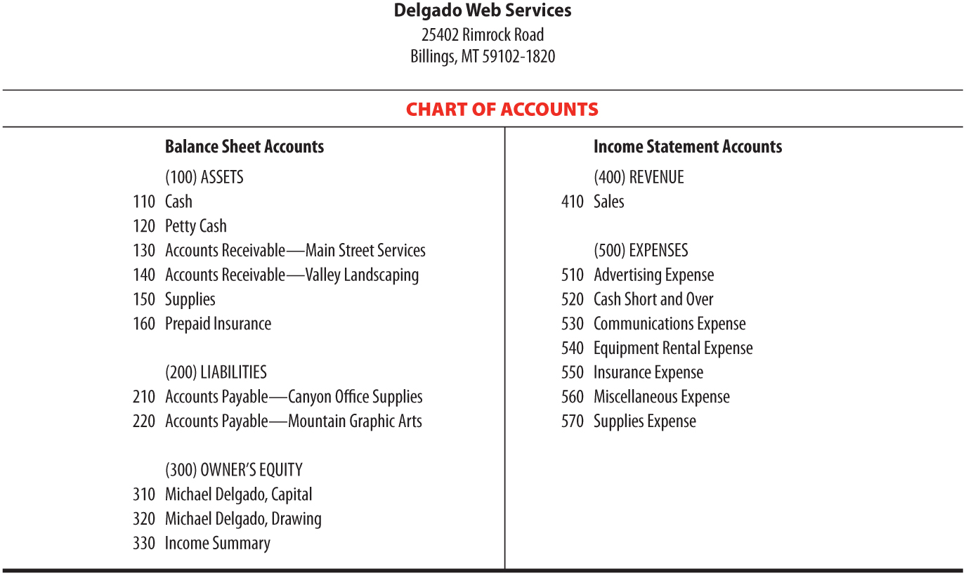
Chart of Accounts
Lesson 4-1
LO1

Slide 5
Chart of Accounts
Lesson 4-1
LO1
A group of accounts is called a ledger.
A ledger that contains all accounts needed to prepare financial statements is called a general ledger.
The name given to an account is known as an account title.
The number assigned to an account is called an account number.

Slide 6

Account Numbers
Lesson 4-1
LO2

Slide 7
Assigning Account Numbers
Lesson 4-1
LO3
The procedure for arranging accounts in a general ledger, assigning account numbers, and keeping records current is called file maintenance.

Slide 8
Assigning Account Numbers
Lesson 4-1
LO3
560 Miscellaneous Expense (Existing account)
570 Supplies Expense (Existing account)
565 Postage Expense (New Account)
570 Supplies Expense (Existing account)
580 Water Expense (New Account)

Slide 9
Opening an Account in a General Ledger
Lesson 4-1
LO4
Writing an account title and number on the heading of an account is called opening an account.

Slide 10
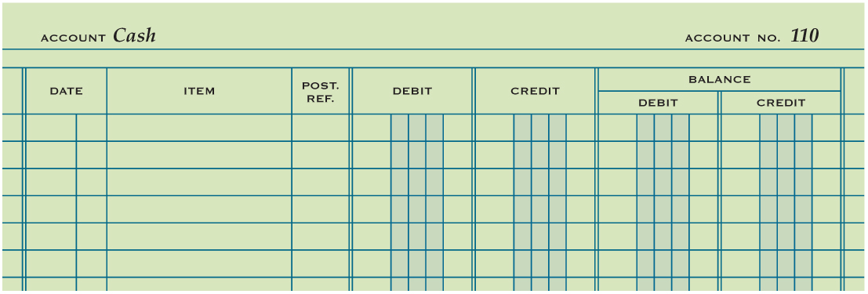
Opening an Account in a General Ledger
Lesson 4-1
LO4
1
2
1. Write the account title, Cash, after the word Account in the heading.
2. Write the account number, 110, after the words Account No. in the heading.

Slide 11

Lesson 4-1 Audit Your Understanding
Lesson 4-1
1. Describe the two parts of an account number.
ANSWER
The first digit indicates in which general ledger division the account is located.
The second and third digits indicate the location of the account within that division.

Slide 12
Lesson 4-1 Audit Your Understanding
Lesson 4-1
2. List the two steps for opening an account.
ANSWER
1. Write the account title after the word Account in the heading.
2. Write the account number after the words Account No. in the heading.

Slide 13
On your own 4-1
Open Excel. Save as initials own4-1 in your folder.
Complete #1 and # 2 Only
Prepare an attractive Chart of Accounts
Use the Delgado sample on page 94 as a guide.
Include the Company Name. Insert a piece of clipart at the top.
Print when you are finished and turn in.

Slide 14

Learning Objectives
LO5 Post amounts from a general journal.
LO6 Demonstrate how to prove cash.
© 2014 Cengage Learning. All Rights Reserved.

Slide 15
Posting an Amount from the Debit Column of a General Journal
Lesson 4-2
LO5
Transferring information from a journal entry to a ledger account is called posting.

Slide 16
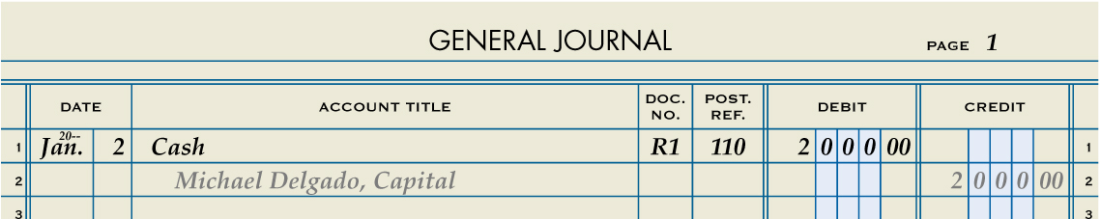
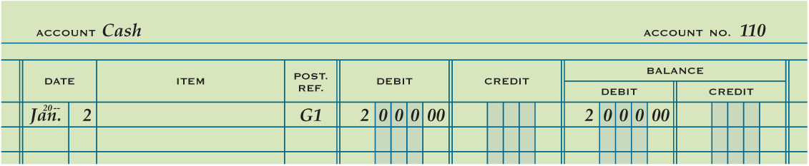
Posting an Amount from the Debit Column of a General Journal
Lesson 4-2
LO5
2
1
3
5
4
1. Write the date.
4. Write the new account balance.
2. Write the journal page number.
5. Return to the journal and write the account number.
3. Write the debit amount.

Slide 17
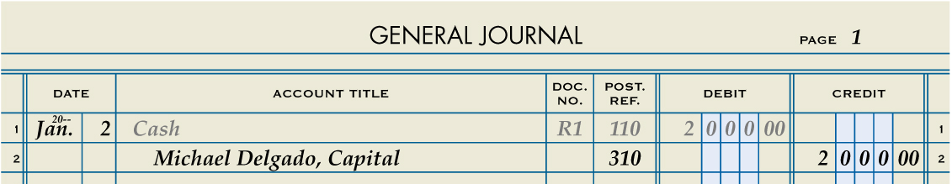
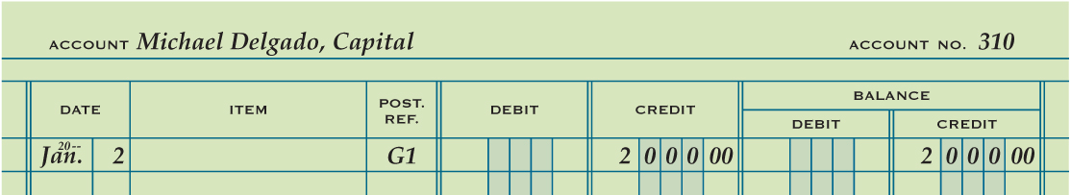
Posting an Amount from the Credit Column of a General Journal
Lesson 4-2
LO5
2
1
3
5
4
1. Write the date.
4. Write the new account balance.
2. Write the journal page number.
5. Return to the journal and write the account number.
3. Write the credit amount.

Slide 18
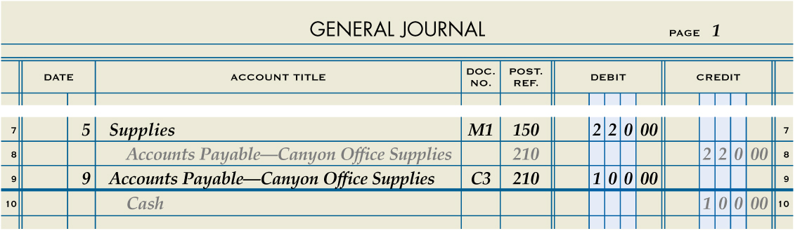
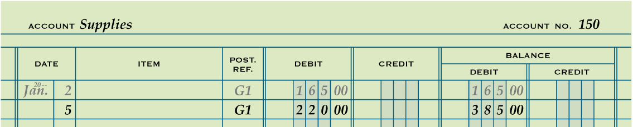
Posting a Debit Amount to an Account with a Balance
Lesson 4-2
LO5
2
1
3
5
4
1. Write the date.
4. Write the new account balance.
2. Write the journal page number.
5. Return to the journal and write the account number.
3. Write the debit amount.

Slide 19
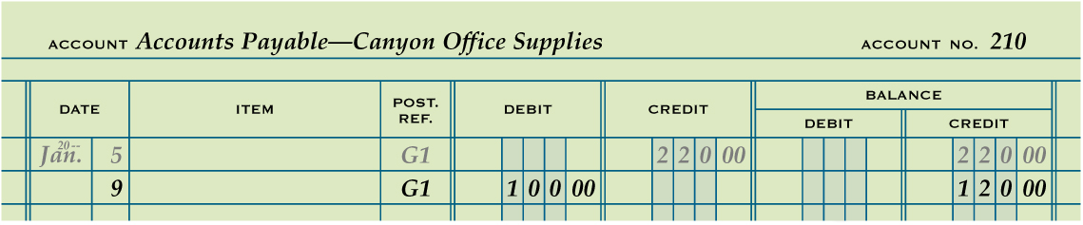
Posting a Debit Amount to an Account with a Credit Balance
Lesson 4-2
LO5
2
1
3
5
4
1. Write the date.
4. Write the new account balance.
2. Write the journal page number.
5. Return to the journal and write the account number.
3. Write the debit amount.

Slide 20
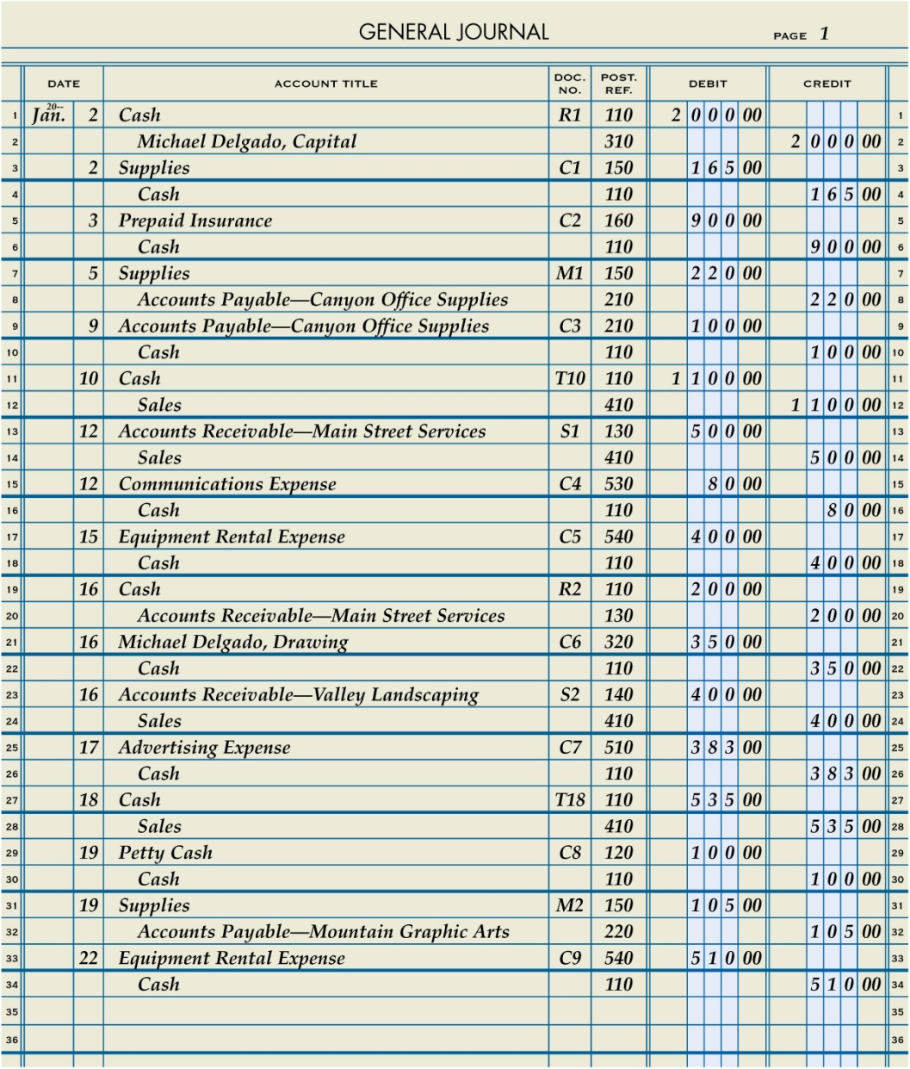
Journal Page with Posting Completed
Lesson 4-2
LO5

Slide 21
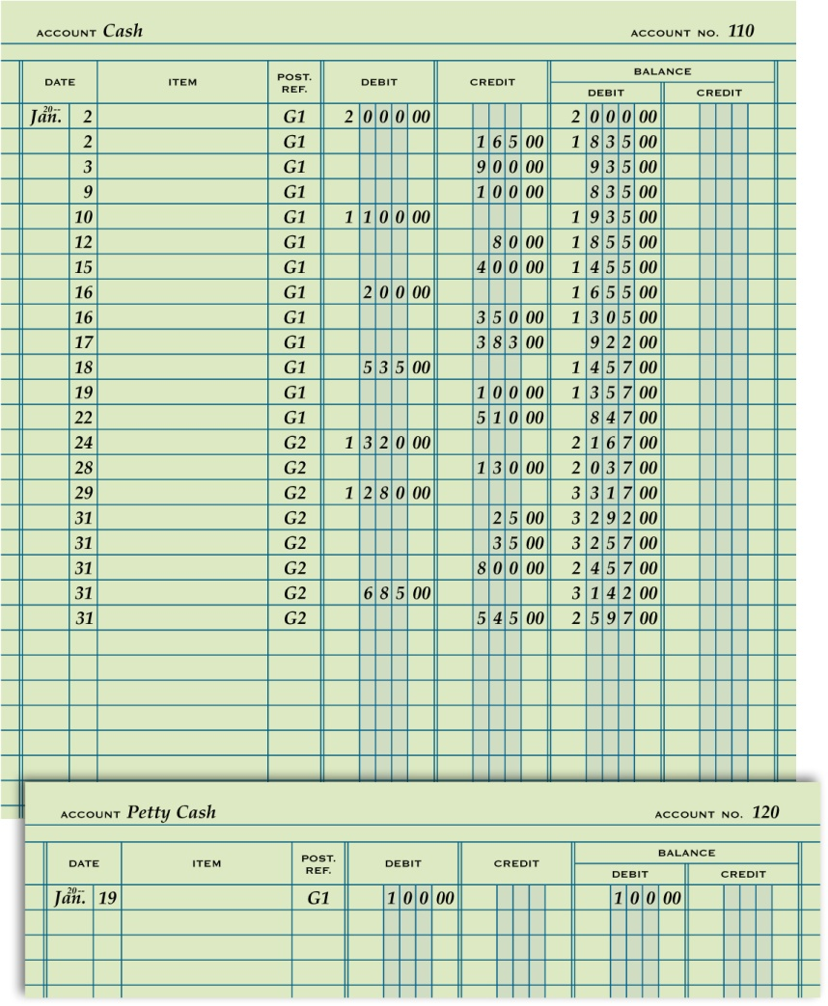
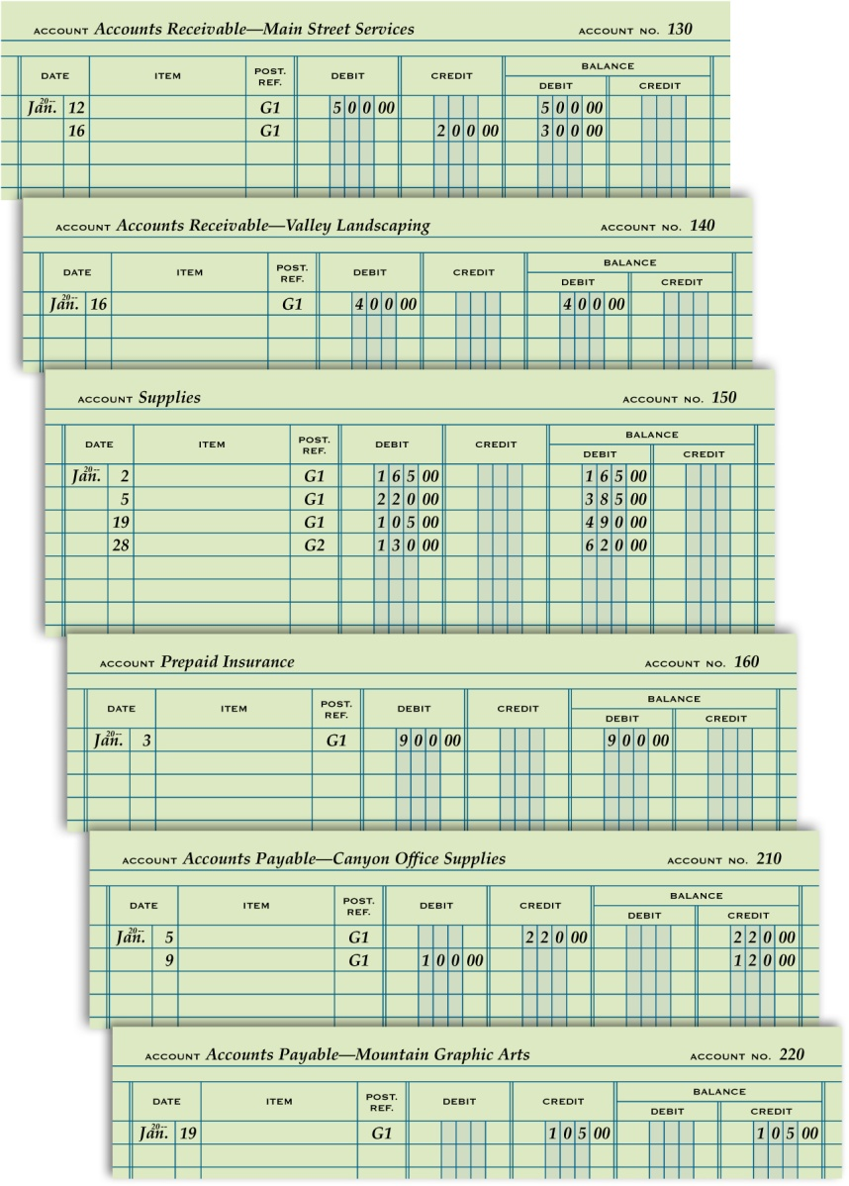
General Ledger with Posting Completed
Lesson 4-2
LO5

Slide 22
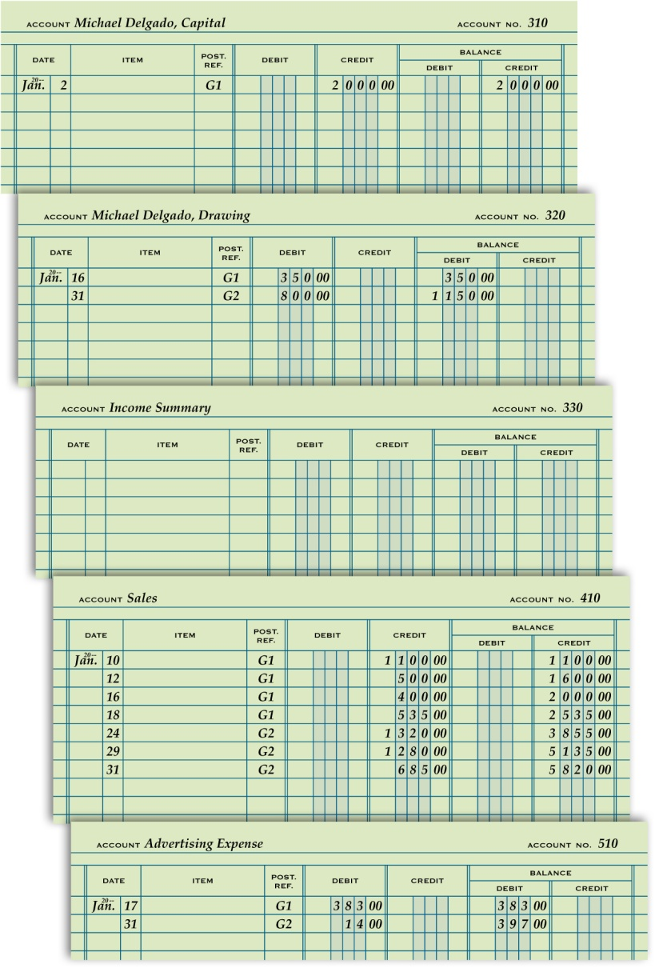
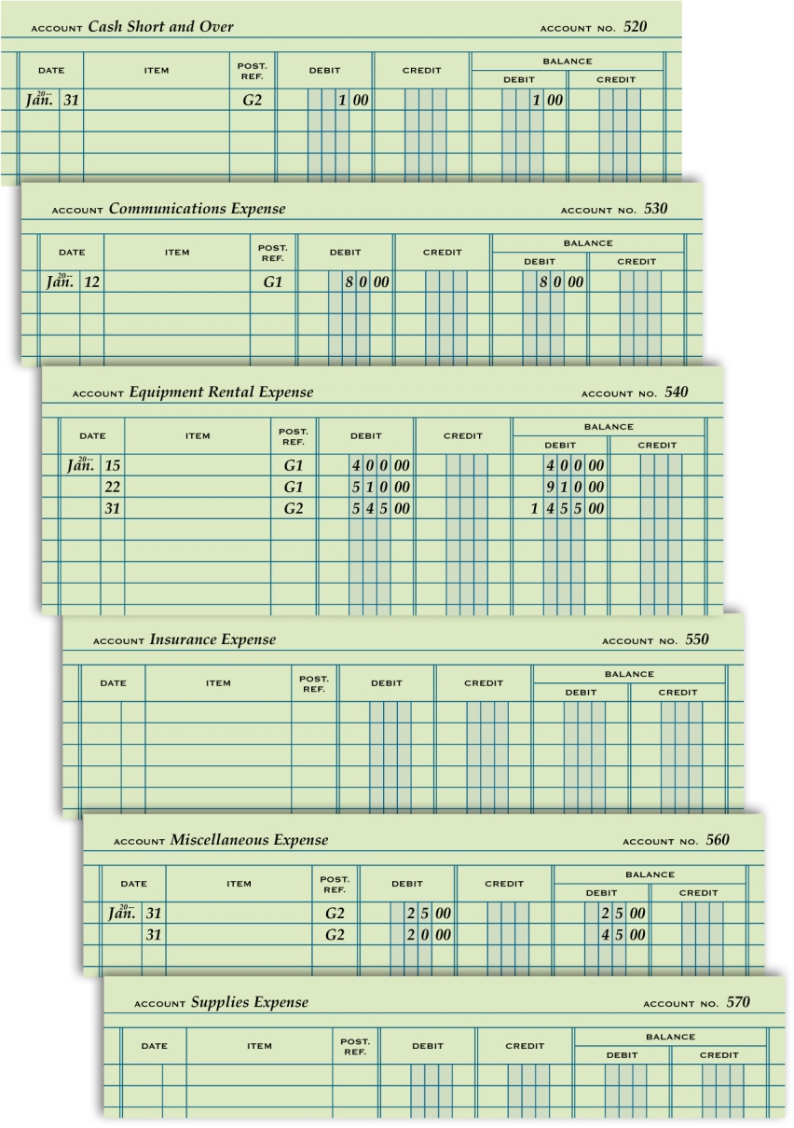
General Ledger with Posting Completed
Lesson 4-2
LO5

Slide 23
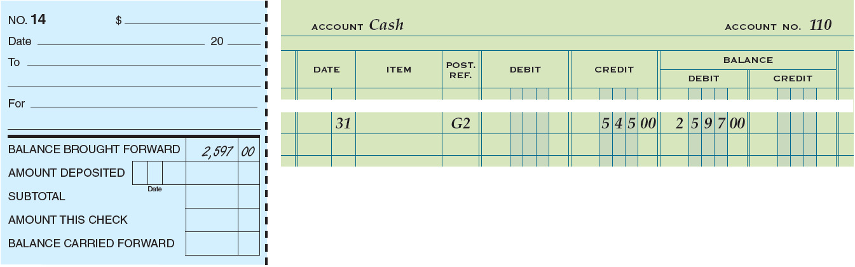
Proving Cash
Lesson 4-2
LO6
Determining that the amount of cash agrees with the balance of the Cash account in the accounting records is called proving cash.
If the cash balance as shown in the checkbook equals the cash balance in the Cash account, cash is proved.

Slide 24
Lesson 4-2 Audit Your Understanding
Lesson 4-2
1. List the five steps of posting from the general journal to the general ledger.
ANSWER
1. Write the date in the Date column of the account.
2. Write the journal page number in the Post. Ref. column of the account.
3. Write the amount in the Debit or Credit column.
4. Calculate and write the new account balance in the Balance Debit or Balance Credit column.
5. Return to the journal and write the account number in the Post. Ref. column of the journal.

Slide 25
Lesson 4-2 Audit Your Understanding
Lesson 4-2
2. When both debit and credit amounts have been posted to an account, what determines whether the balance is a debit or a credit?
ANSWER
Whenever the debits in an account exceed the credits, the balance is a debit.
Whenever the credits in an account exceed the debits, the balance is a credit.

Slide 26
Lesson 4-2 Audit Your Understanding
Lesson 4-2
3. Which two amounts are compared when proving cash?
ANSWER
The cash balance as shown in the checkbook and the cash balance in the Cash account.

Slide 27
work together 4-2 on your own 4-2
Open 4-2 work.xls file (May be provided as handouts)
Get 1 piece of journal paper and 2 pages with opened accounts. Remember to write your name at the top of each page.
Post all the entries in the general journal to your General Ledger pages.
work together will be completed in class
Open 4-2 own.xls file (May be as provided handouts)
Post all entries in the general journal to your General Ledger pages.
Staple each set of pages together and turn in.

Slide 28

Learning Objectives
LO7 Analyze incorrect journal entries and prepare correcting entries.
LO8 Demonstrate how to correct errors made during the posting process.
© 2014 Cengage Learning. All Rights Reserved.

Slide 29
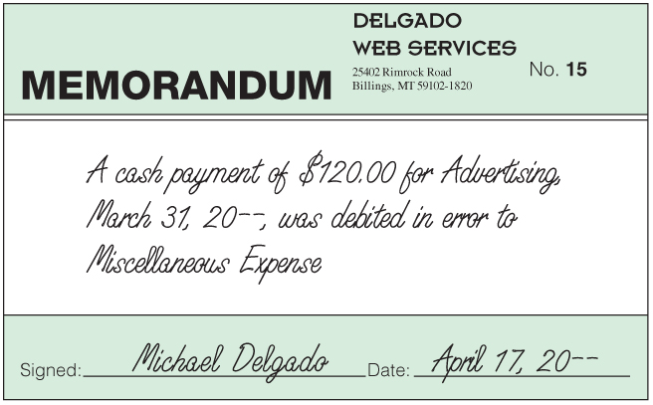
Memorandum for a Correcting Entry
Lesson 4-3
LO7
An incorrect journal entry should be corrected with an additional journal entry, called a correcting entry.
A memorandum is prepared as the source document describing the correction to be made.

Slide 30
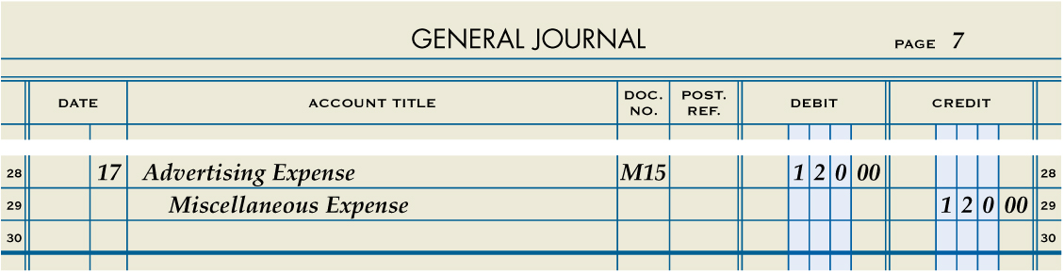
Journal Entry to Record a Correcting Entry
Lesson 4-3
LO7
April 17. Discovered that a payment of cash for advertising in March was journalized and posted in error as a debit to Miscellaneous Expense instead of Advertising Expense, $120.00. Memorandum No. 15.
Advertising Expense
120.00
Miscellaneous Expense
120.00
Date
1
Debit
2
4
Source Document
3
Credit

Slide 31
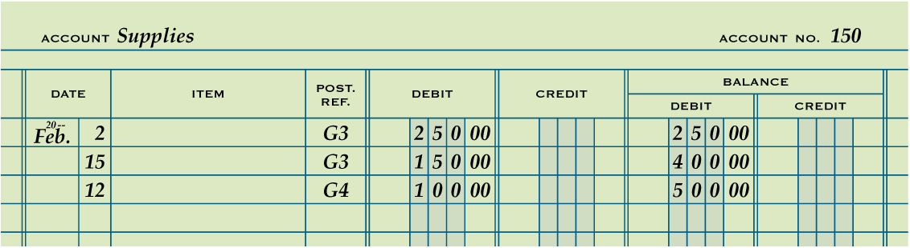
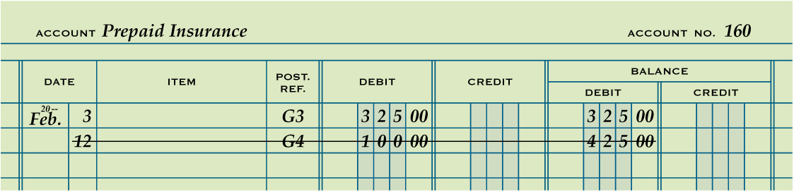
Correcting an Error in Posting to the Wrong Account
Lesson 4-3
LO8
2
1
1. Draw a line through the entire incorrect entry.
2. Record the posting in the correct account. Recalculate the account balance.

Slide 32
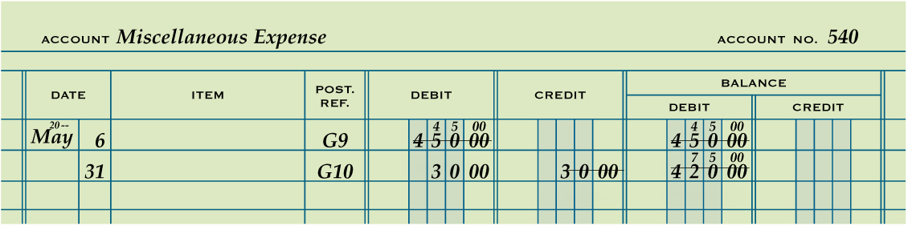
Correcting an Incorrect Amount
Lesson 4-3
LO8
1
2
3
1. Draw a line through the incorrect amount.
2. Write the correct amount just above the incorrect amount in the same space.
3. Recalculate the account balance.

Slide 33
Correcting an Amount Posted to the Wrong Column
Lesson 4-3
LO8
5
4
6
4. Draw a line through the incorrect item in the account.
5. Record the posting in the correct amount column.
6. Recalculate the account balance.

Slide 34
Lesson 4-3 Audit Your Understanding
Lesson 4-3
1. What is a correcting entry?
ANSWER
A journal entry made to correct an error in the ledger

Slide 35
Lesson 4-3 Audit Your Understanding
Lesson 4-3
2. When is a correcting entry necessary?
ANSWER
When a transaction has been improperly journalized and posted to the ledger

Slide 36
Lesson 4-3 Audit Your Understanding
Lesson 4-3
3. What are the three steps for correcting an incorrect amount posted to an account?
ANSWER
1. Draw a line through the incorrect amount.
2. Write the correct amount just above the correction in the same space.
3. Recalculate the account balance.

Slide 37
Lesson 4-3 Audit Your Understanding
Lesson 4-3
4. What are the three steps for correcting an amount posted to an incorrect column?
ANSWER
1. Draw a line through the incorrect item in the account.
2. Record the posting in the correct amount column.
3. Recalculate the account balance.

Slide 38
Work Together 4-3 On You Own 4-3
Work Together
Model
On Your Own
Complete

Slide 39
Application Problems
4-2 Application Problem
Excel
4-3 Application Problem
Self-Correcting Excel
4-M Mastery Problem
Peachtree

Slide 40
4-S Source Documents Problem
Open Excel worksheet Unit 4 Source Documents and save into your folder.
Work with Partner – Place both names on assignment.
Refer to the source document files and journalize the transactions for July using the General Journal tab.
Post from the General Journal to the General Ledger accounts on the General Ledger tab.
Prove cash – your cash balance should be $7,086.00
See Mr. Bacu if you want to check your balances before you print.
Print the General Journal and General Ledger.

Slide 41
Unit 4 Assessment
Unit 4 Review (ExamView)
90 % or Greater
5 Point Bonus on Unit 1 Concept Quiz (20% Bonus)
Unit 4 Part 1 Quiz (ExamView)
Concepts – 25 Questions (25 Points)
Unit 4 Part 2 Quiz (Excel)
Skills (40 Points)

